Slide 1
DA MOTORLARI
DOÇ. DR. ORHAN KAPLAN
EE-313 ELEKTRİK MAKİNALARI I
HAFTA 6

Slide 2
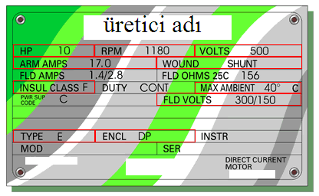
DA MOTORLARIN HIZ REGÜLASYONU
Etiket değerleri

Slide 3
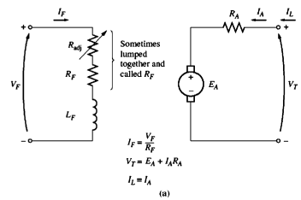
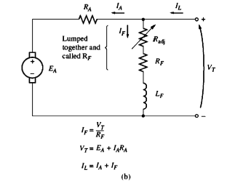
DA MOTORLARIN ELEKTRİK DEVRE MODELLERİ
Yabancı uyartımlı DA motor
Şönt DA motor

Slide 4
DA MOTORLARIN TERMİNAL KARAKTERİSTİKLERİ

Slide 5
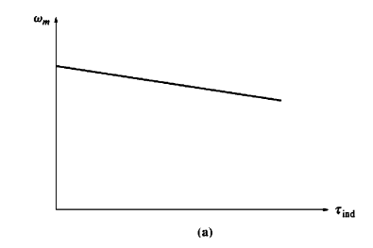
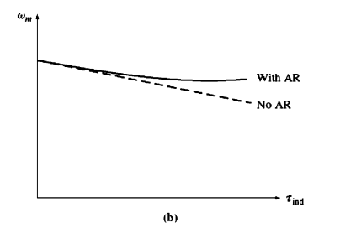
DA ŞÖNT MOTOR ÇIKIŞ KARAKTERİSTİĞİ

Slide 6
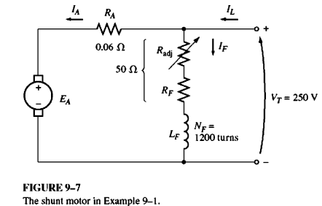

Slide 7
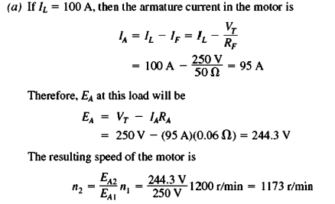
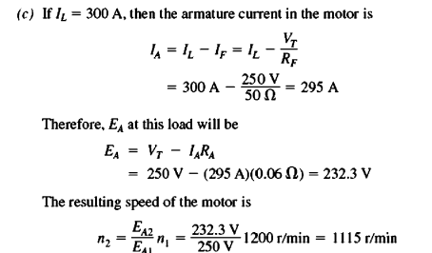
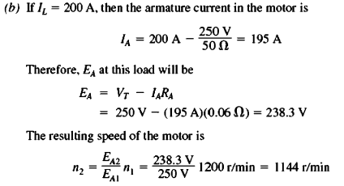

Slide 8
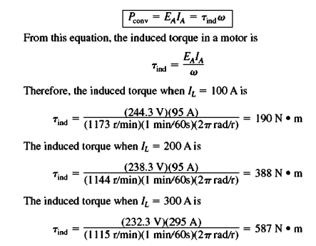
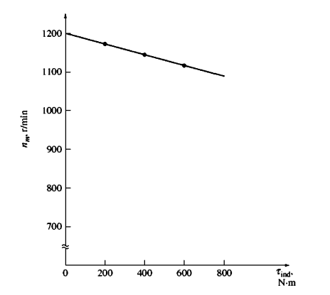

Slide 9
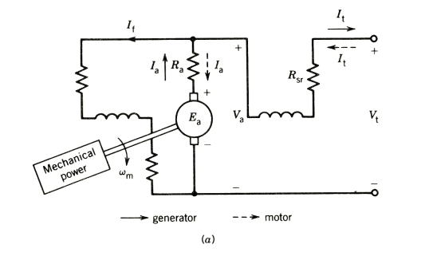
Shunt dc machine equivalent circuit.

Slide 10
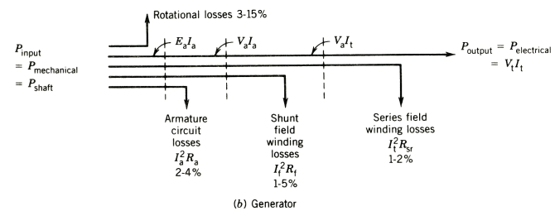

Slide 11
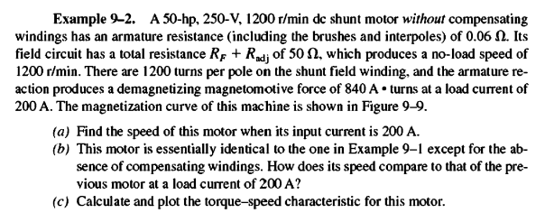
DA ŞÖNT MOTORUN LİNEER OLMAYAN ANALİZ

Slide 12
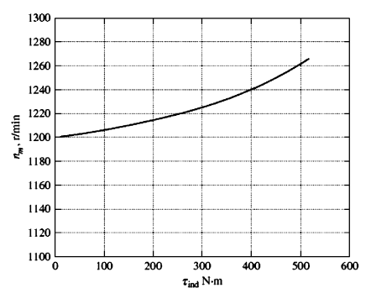
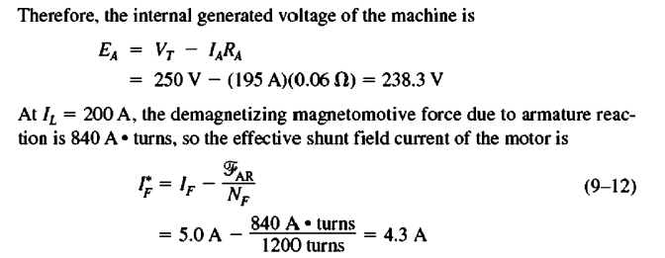
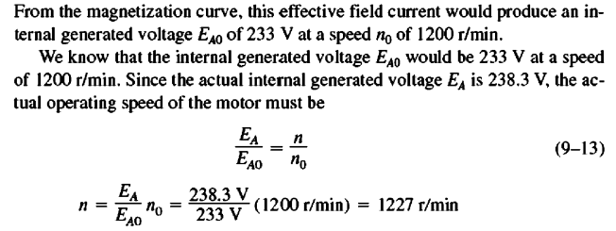

Slide 13
Ex. 3. A 12 kW, 100 V, 1000 rpm dc shunt generator has armature resistance Ra =0,1 Ω, shunt ﬁeld winding resistance R_{fw} =80 Ω, and N_{f} =1200 turns per pole. The rated ﬁeld current is 1 ampere. The magnetization characteristic at 1000 rpm is shown in Fig. 4.24. The dc machine is connected to a 100 V dc supply and is operated as a dc shunt motor. At no-load condition, the motor runs at 1000 rpm, and the armature takes 6 amperes.
(a) Find the value of the resistance of the shunt ﬁeld control rheostat (R_{fc}).
(b) Find the rotational losses at 1000 rpm.
(c) Find the speed, electromagnetic torque, and efﬁciency of the motor when rated current
ﬂows in the armature.
(i) Consider that the air gap ﬂux remains the same as that at no load.
(ii) Consider that the air gap ﬂux is reduced by 5% when rated current ﬂows in the
armature because of armature reaction.

Slide 14
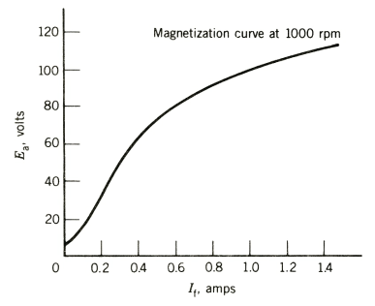

Slide 15
DA MOTOR MAKSİMUM GÜÇ ŞARTLAR

Slide 16
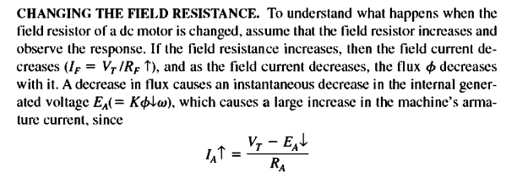
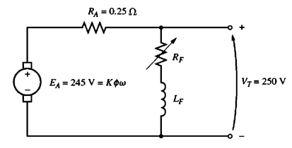
DA ŞÖNT MOTOR HIZ KONTROLÜ

Slide 17
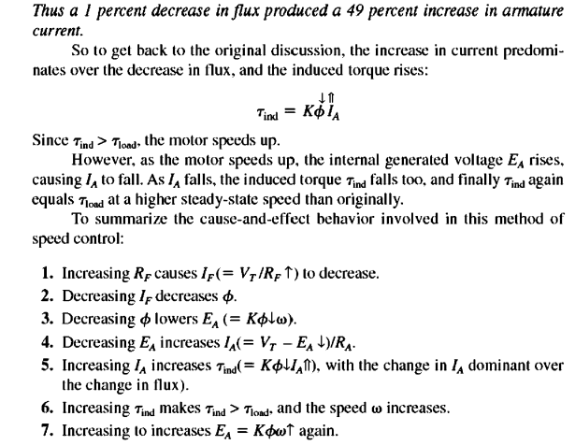
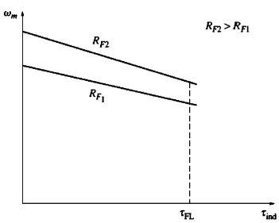
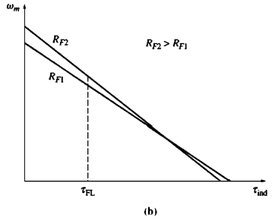

Slide 18
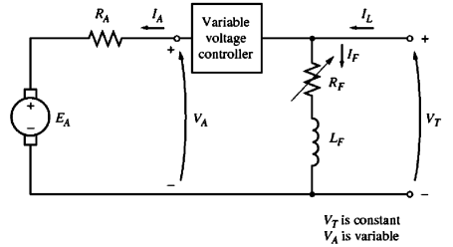
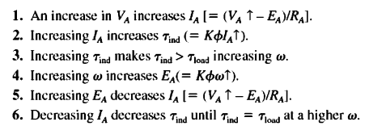

Slide 19
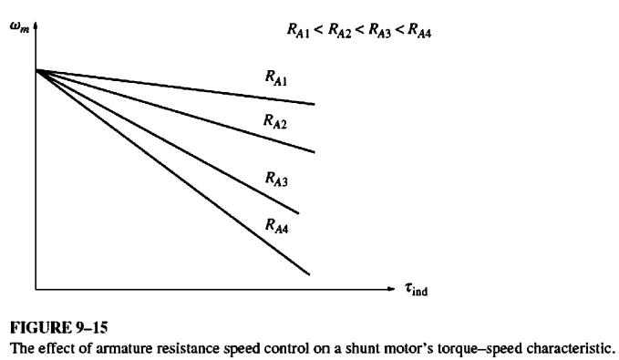

Slide 20
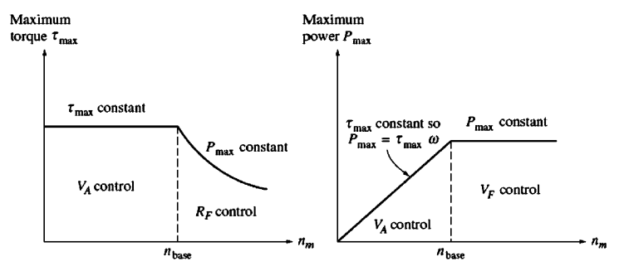
If the motor is operating at its rated voltage, field current, and power, it will be turning at base speed. Armature voltage control can control the speed of the motor for speeds below base speed but not for speeds above base speed. To achieve a speed faster than base speed by armature voltage control would require excessive armature voltage, possibly damaging the armature circuit.

Slide 21
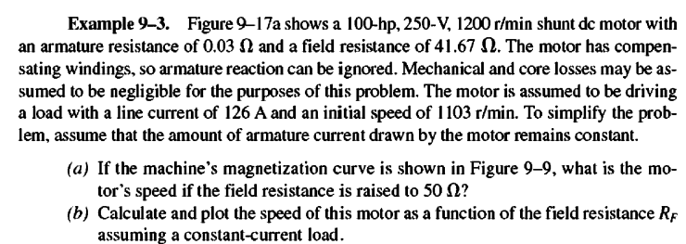
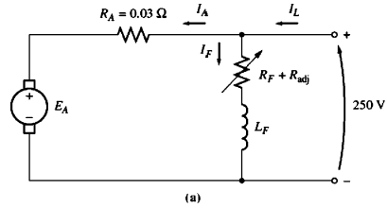

Slide 22
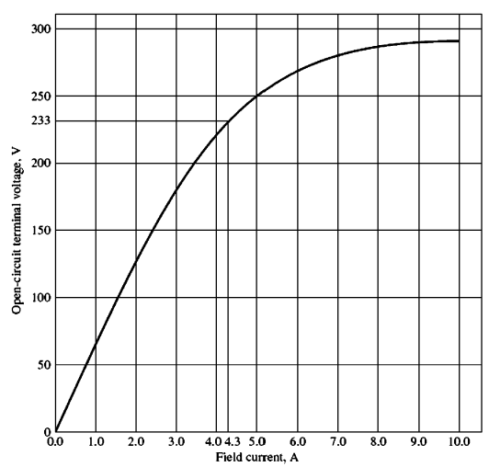

Slide 23
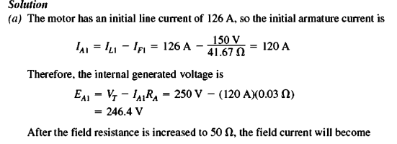
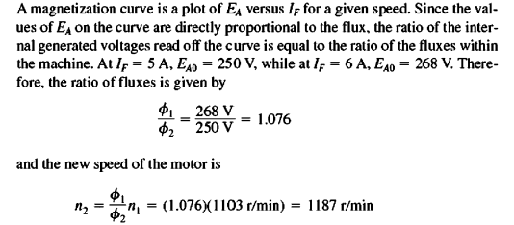
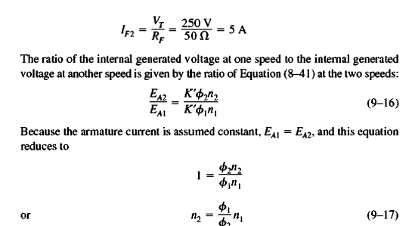
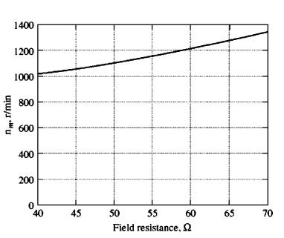

Slide 24
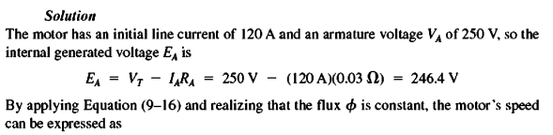
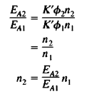
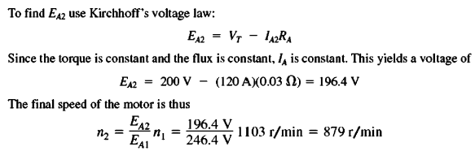

Slide 25
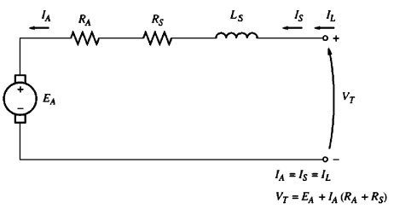
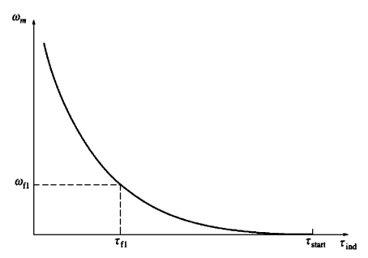
DA SERİ MOTOR

Slide 26
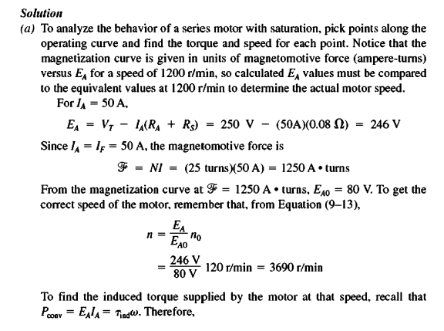

Slide 27
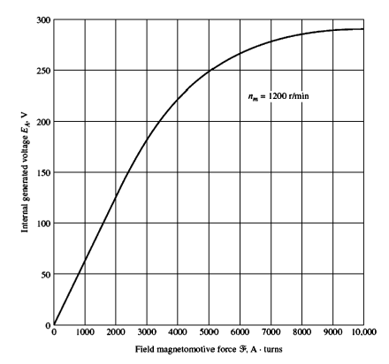
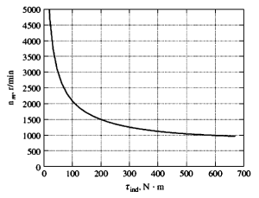

Slide 28
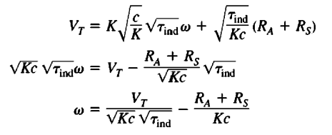

Slide 30
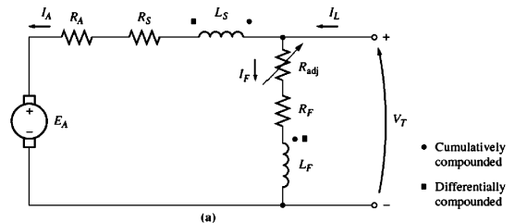
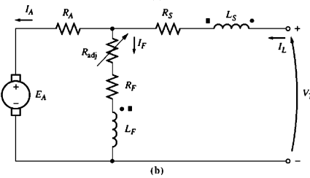
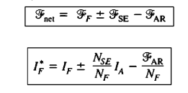
Kompund DA Motor

Slide 31
Kaynaklar
Electric Machinery Fundamentals, Stephen J. Chapman
Principles Of Electric Machines And Power Electronics, P. C. SEN
Fundamentals of Electromechanical Energy Conversion, Jacek F. Gieras
Electrical Machines with MATLAB, Turan Gönen

