Slide 1
Transformatörler
Doç. Dr. Orhan KAPLAN
EE-313 Elektrik Makinaları I

Slide 2
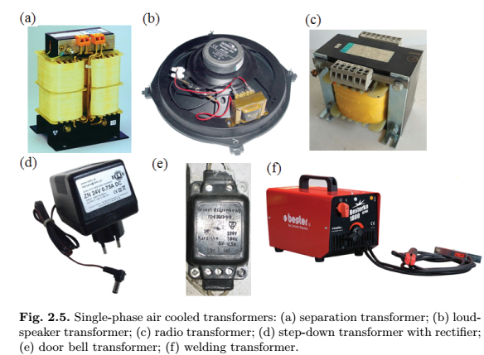
Construction of transformer

Slide 3
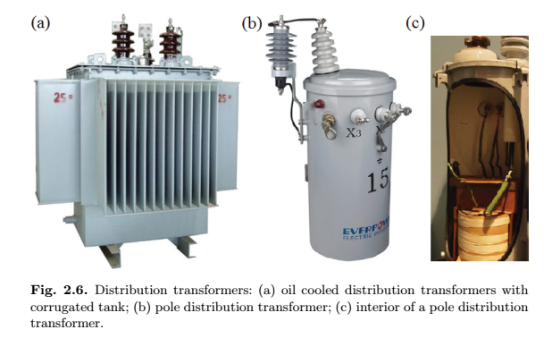
Construction of transformer

Slide 4
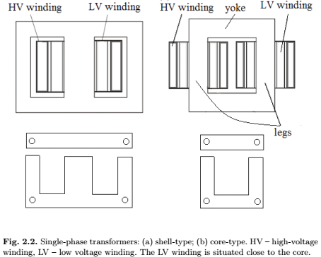
Construction of transformer

Slide 5
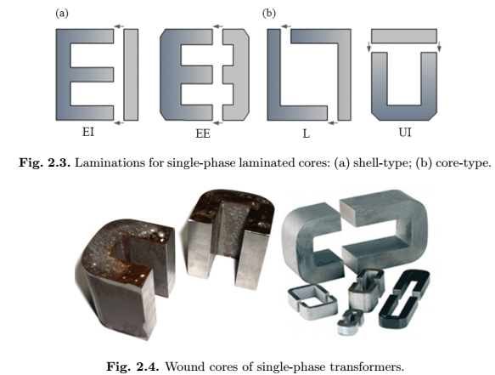
Construction of transformer

Slide 6
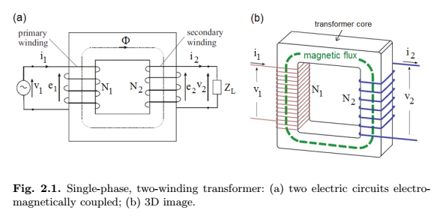
Transformer operation

Slide 7
Ideal single-phase transformer

Slide 8
Ideal single-phase transformer
$$a transformatör dönüştürme oranı$$

Slide 9
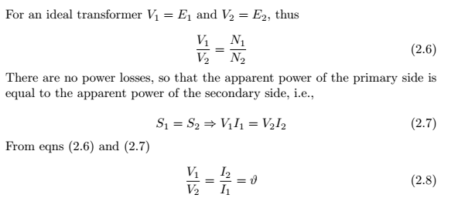
Ideal single-phase transformer
$$a$$
$$a$$
$$a$$

Slide 10
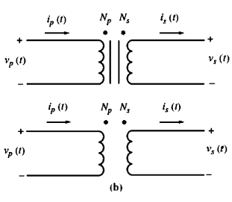
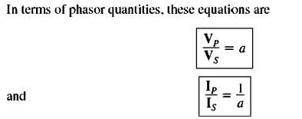
Ideal single-phase transformer

Slide 11
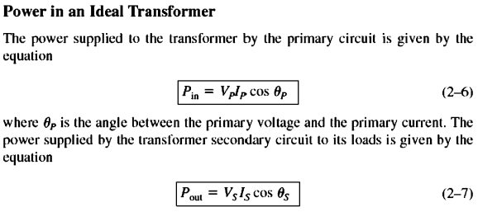
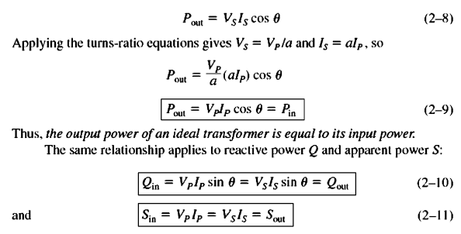

Slide 12
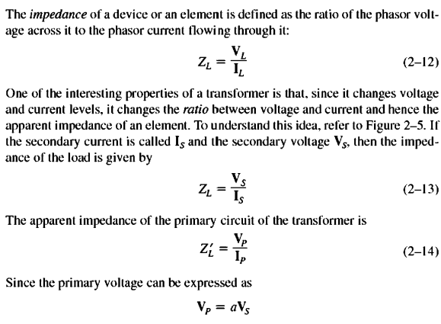
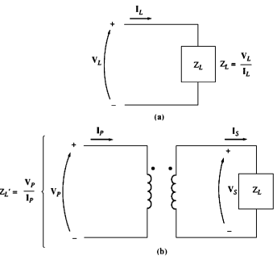
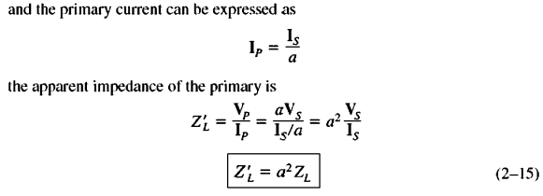

Slide 13
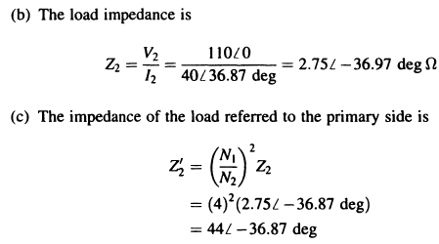
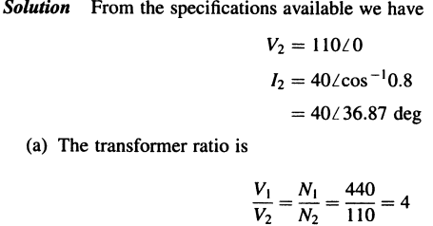
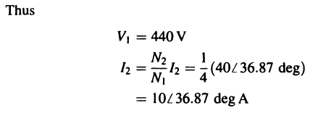

Slide 14
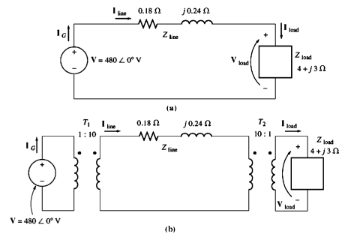
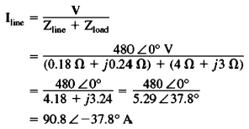
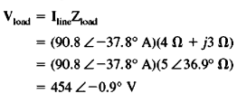

Slide 15
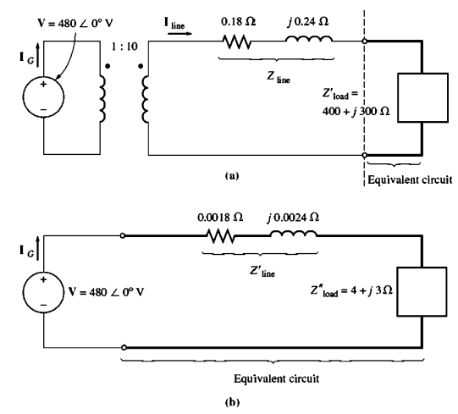
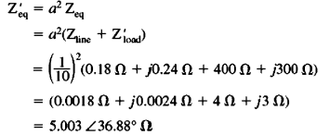

Slide 16
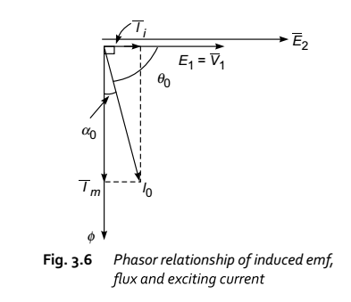
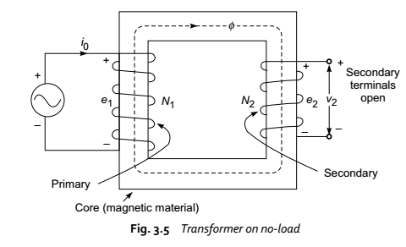
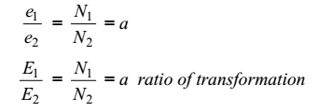

Slide 17
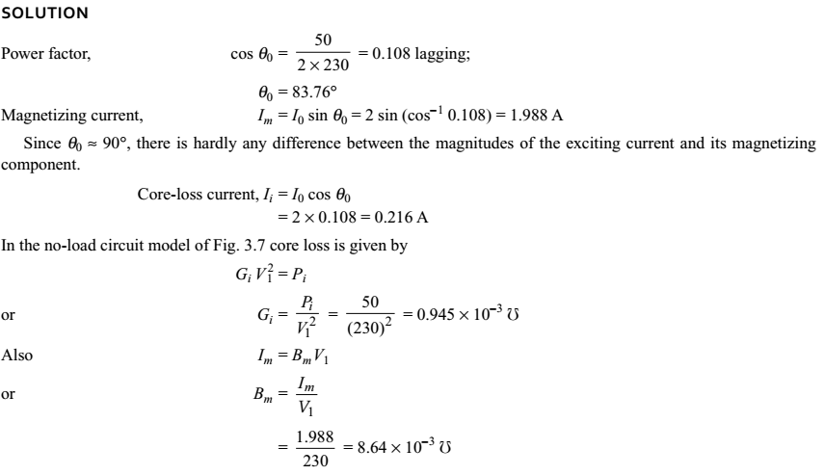

Slide 18
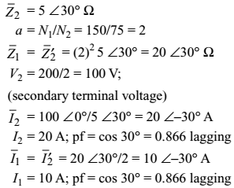
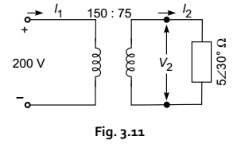
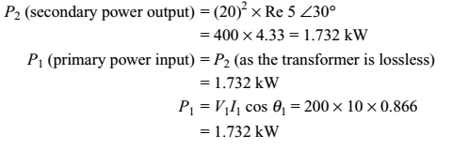

Slide 19
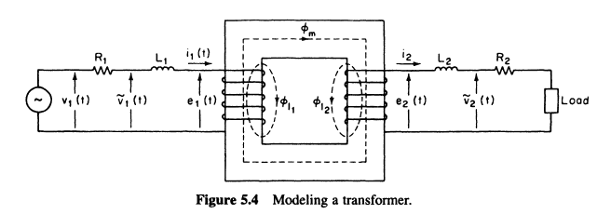

Slide 20
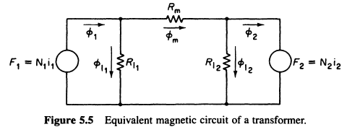

Slide 22
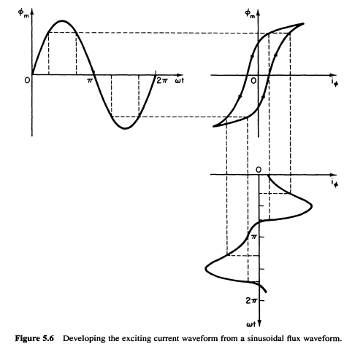

Slide 23
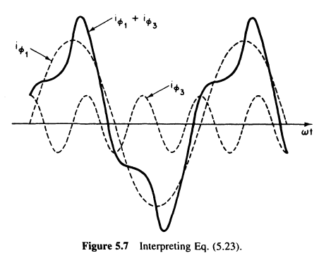
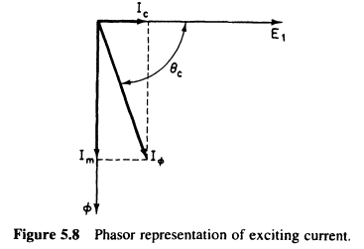

Slide 24
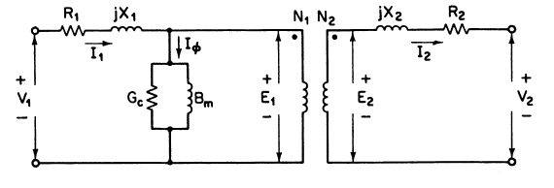
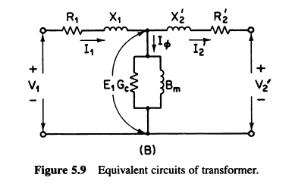
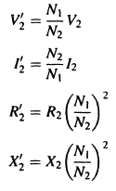

Slide 25
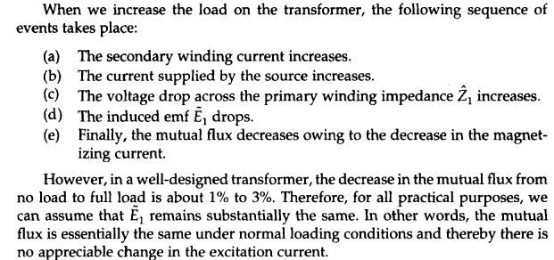

Slide 26
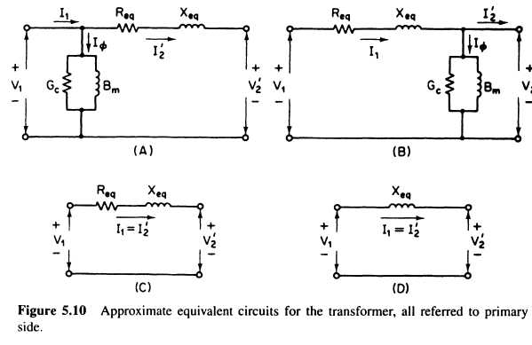

Slide 27
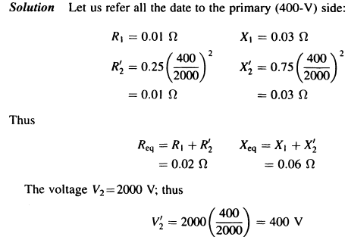

Slide 28
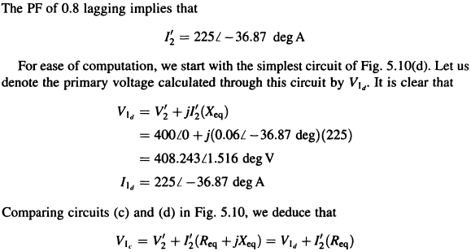

Slide 29
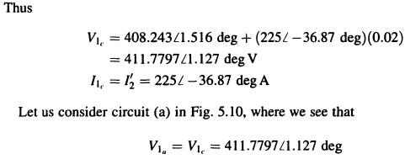
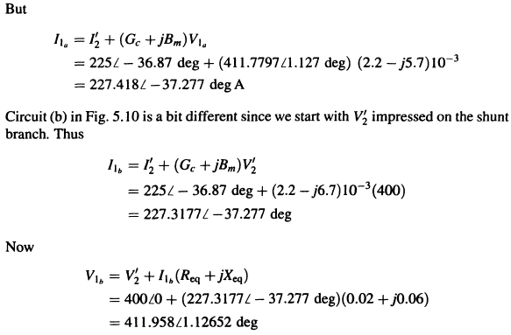

Slide 30
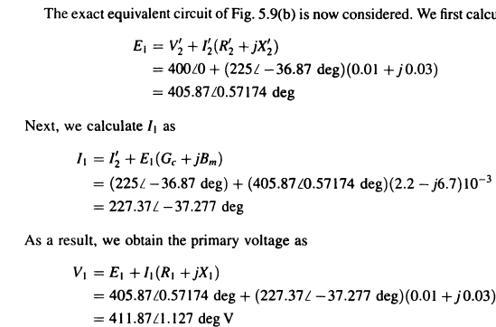

Slide 31
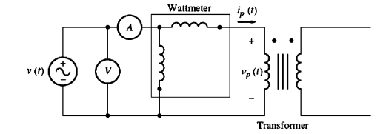
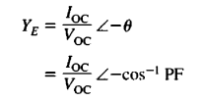

Slide 32
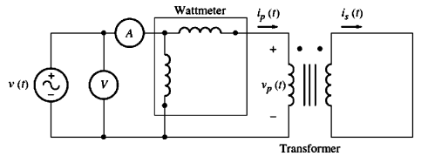

Slide 33
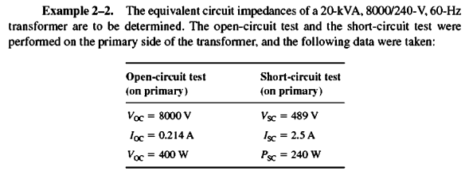
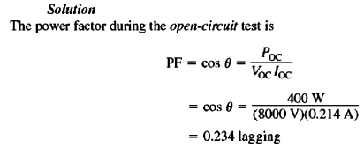

Slide 34
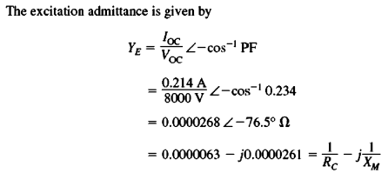
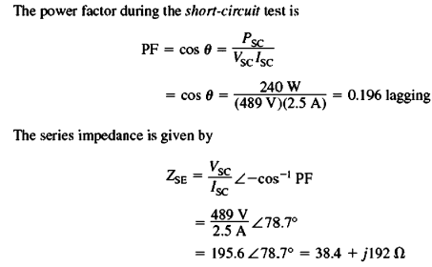

Slide 39
VOLTAGE REGULATION AND EFFICIENCY
=

Slide 58
The Current Transformer
Akım transformatörü, bağlı oldukları devredeki akımı, belirli değerlere indirgeyerek, sekonderine bağlı olan ölçü aletlerine ölçüm için gerekli olan (Genel olarak 1A ve 5A) akımıve izolasyonu sağlayan bir ölçü transformatörüdür.

Slide 59
There are three basic types of current transformers: wound, toroidal and bar.
Wound Current Transformer – The transformers primary winding is physically connected in series with the conductor that carries the measured current flowing in the circuit. The magnitude of the secondary current is dependent on the turns ratio of the transformer.

Slide 60
Toroidal Current Transformer – These do not contain a primary winding. Instead, the line that carries the current flowing in the network is threaded through a window or hole in the toroidal transformer.
Bar-type Current Transformer – This type of current transformer uses the actual cable or bus-bar of the main circuit as the primary winding, which is equivalent to a single turn. They are fully insulated from the high operating voltage of the system and are usually bolted to the current carrying device.

Slide 68
THREE PHASE CIRCUITS AND POWER EQUATIONS

Slide 91
Phase Shift
Some of the three-phase transformer connections will result in a phase shift between the primary and secondary line-to-line voltages.

Slide 96
or

